Slide 1
Module 3

Slide 2
Statement-Level Control Structures
A control structure is a control statement and the statements whose execution it controls.
Selection Statements
Iterative Statements
Unconditional Branching

Slide 3
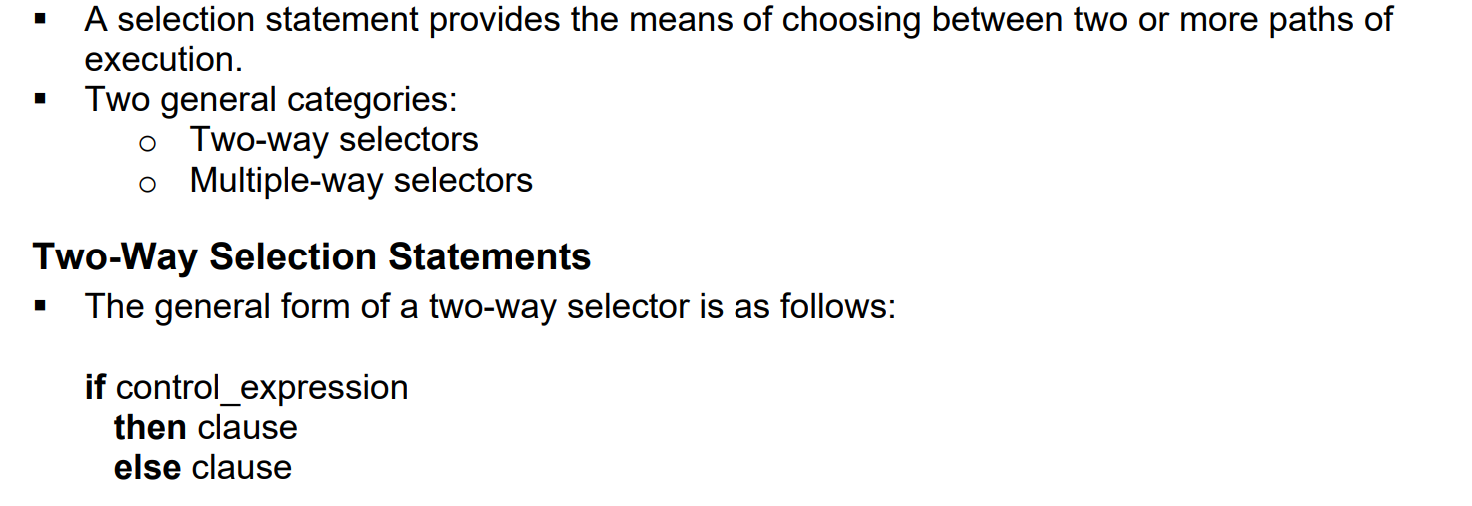
Selection Statements

Slide 4
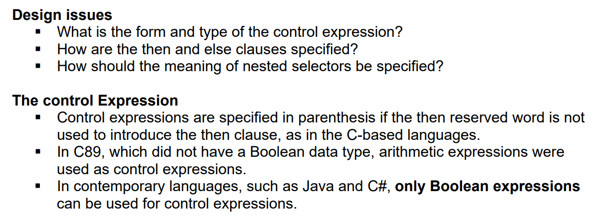

Slide 5
Clause Form
The then and else clauses either appear as single statements or compound statements.
C-based languages use braces to form compound statements.
In Ada, the last clause in a selection construct is terminated with end and if.
One exception is Perl, in which all then and else clauses must be compound statements, even if they contain single statements.
Fortan includes a three-way selector named the arithmetic IF that uses an arithmetic expression for control.
It causes control to go to one of three different labeled statements, depending on whether the value of its control expression is negative, zero, or greater than zero.
This statement is on the obsolescent feature list of Fortran 95.

Slide 6
Python uses indentation to specify compound statements. For example,
if x > y :
x = y
print "case 1“
All statements equally indented are included in the compound statement.
Notice that rather than then, a colon is used to introduce the then clause in Python

Slide 7
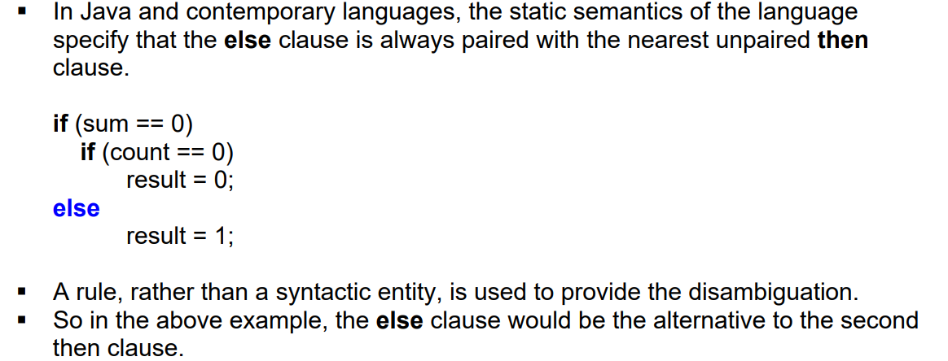
Nesting Selectors

Slide 8
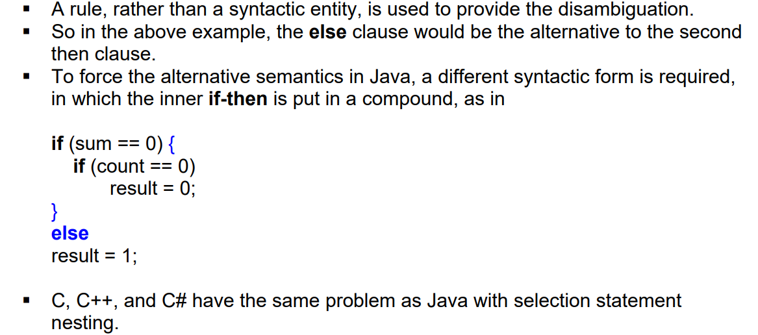

Slide 9
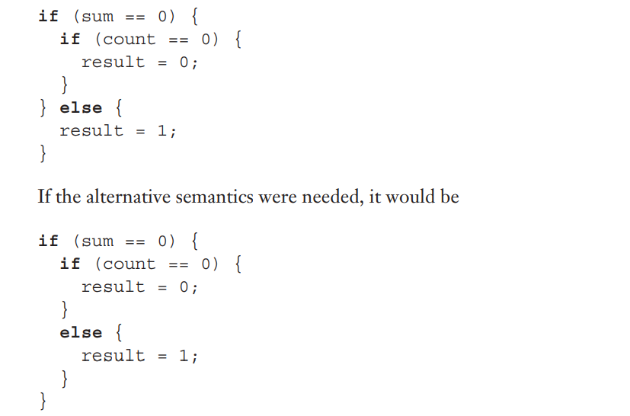
Because Perl requires that all then and else clauses be compound, it does not. In Perl, the previous code would be written as

Slide 10
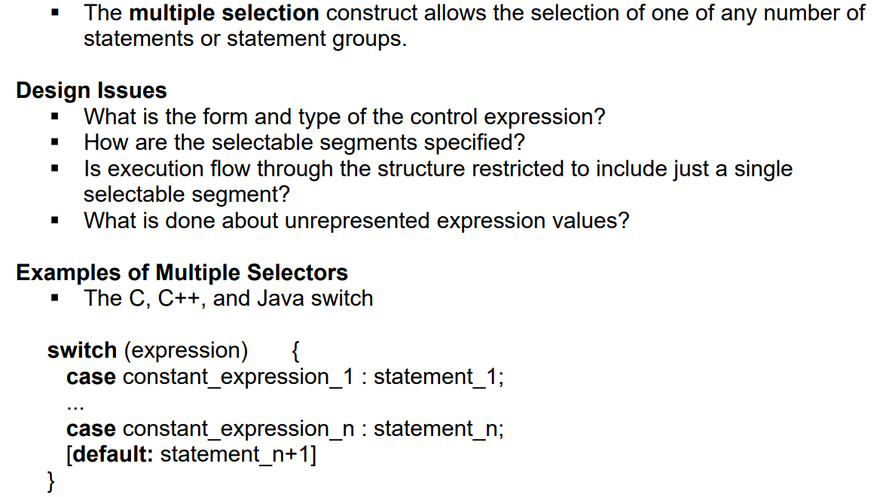
Multiple Selection Constructs

Slide 11
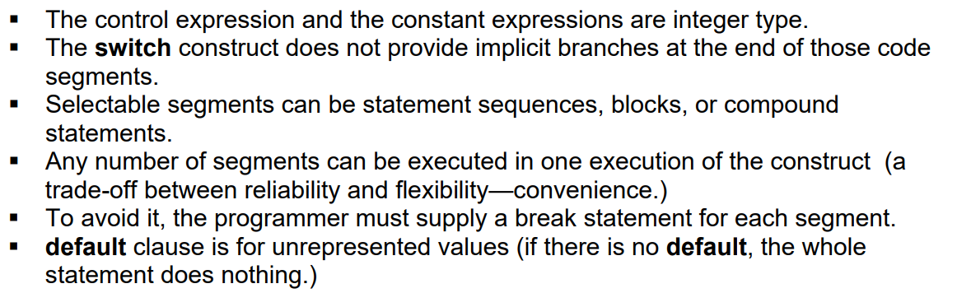

Slide 12
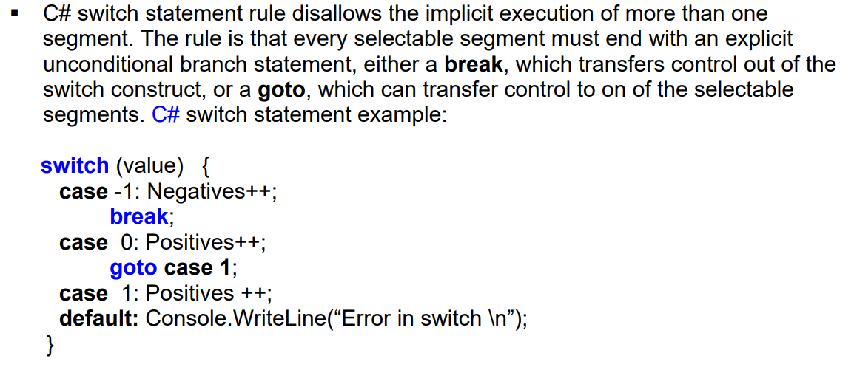

Slide 13
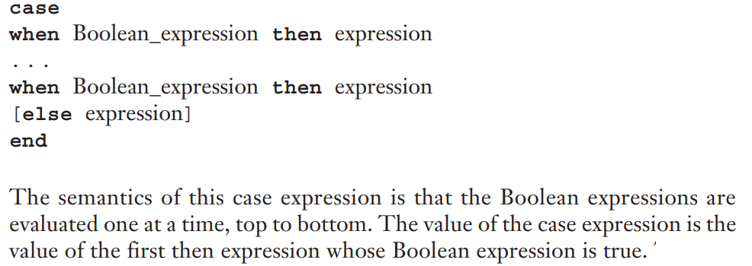
Ruby has two forms of multiple-selection constructs, both of which are called case expressions and both of which yield the value of the last expression evaluated.
The only version of Ruby’s case expressions that is described here is semantically similar to a list of nested if statements:

Slide 14
The else represents true in this statement, and the else clause is optional.
For example,
leap = case
when year % 400 == 0 then true
when year % 100 == 0 then false
else year % 4 == 0
end
This case expression evaluates to true if year is a leap year

Slide 15
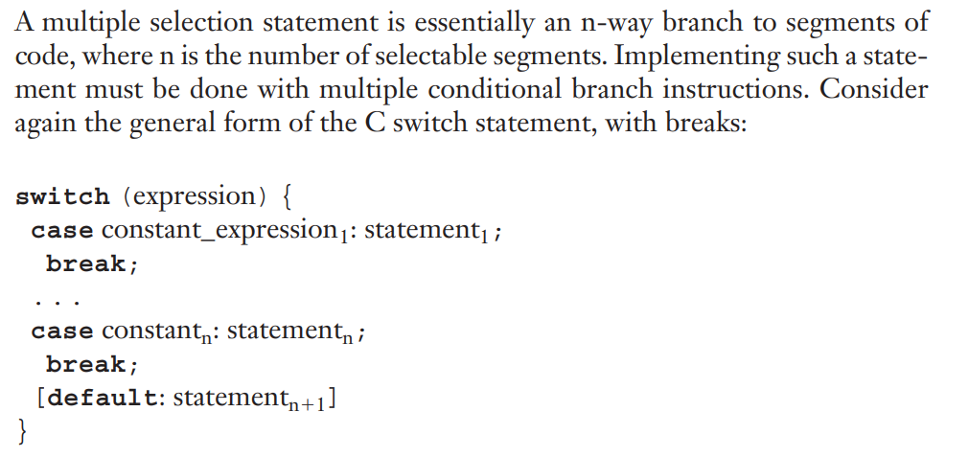
Implementing Multiple Selection Structures

Slide 16
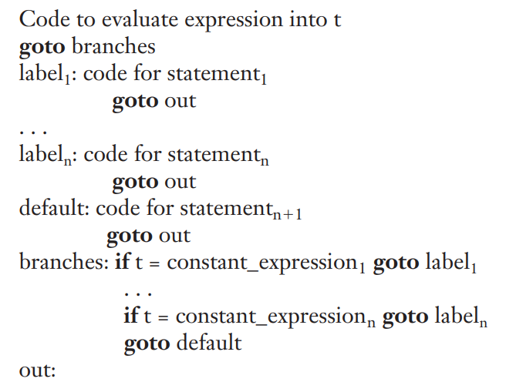

Slide 17
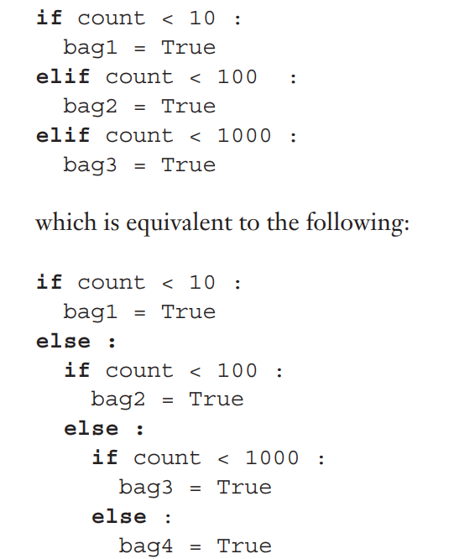
Multiple Selection Using if
In many situations, a switch or case statement is inadequate for multiple selection
Consider the following Python selector statement

Slide 18
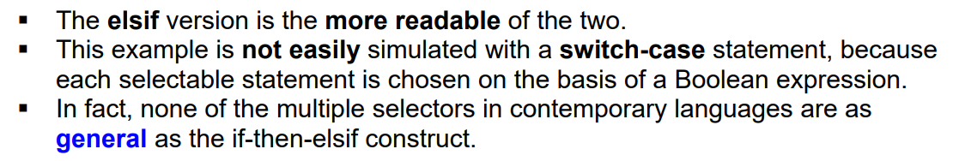

Slide 19
Iterative statement
The repeated execution of a statement or compound statement is accomplished by
iteration zero, one, or more times.
Iteration is the very essence of the power of computer.
The repeated execution of a statement is often accomplished in a functional language by recursion rather than by iteration.
General design issues for iteration control statements:
1. How is iteration controlled?
2. Where is the control mechanism in the loop?

Slide 20
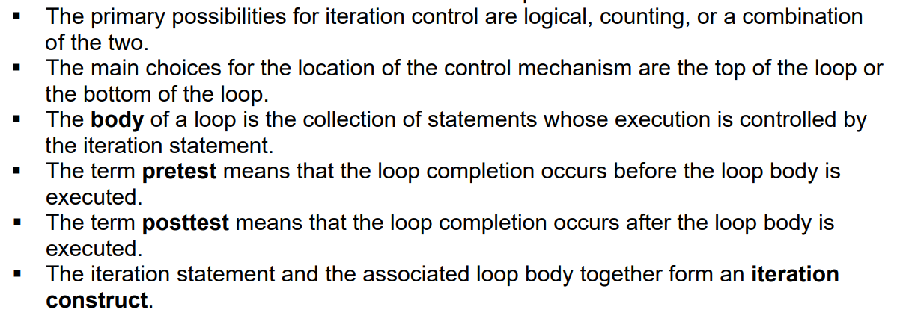

Slide 21
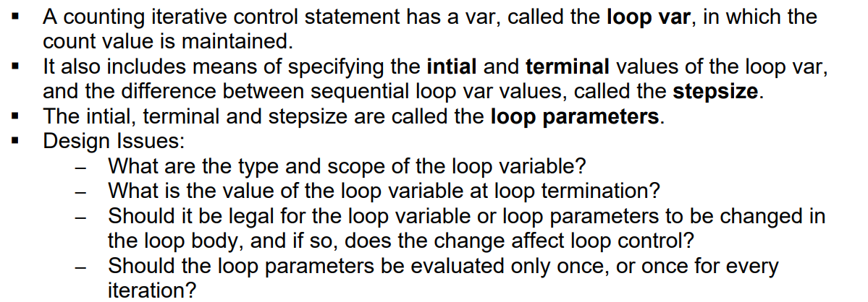
Counter-Controlled Loops

Slide 22
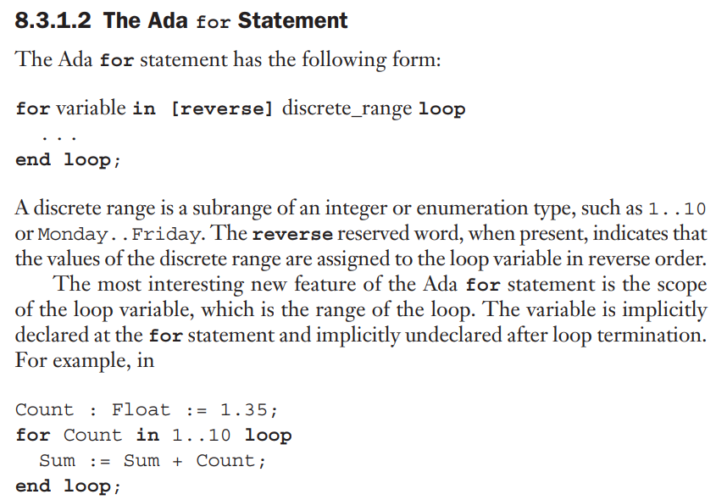

Slide 23
The Float variable Count is unaffected by the for loop.
Upon loop termination, the variable Count is still Float type with the value of 1.35.
Also, the Float-type variable Count is hidden from the code in the body of the loop, being masked by the loop counter Count, which is implicitly declared to be the type of the discrete range, Integer.

Slide 24
The for Statement of the C-Based Languages
The general form of C’s for statement is
for (expression_1; expression_2; expression_3)
loop body
The loop body can be a single statement, a compound statement, or a null statement
Eg:
for (i = 0, j = 10; j == i; i++)
…

Slide 25
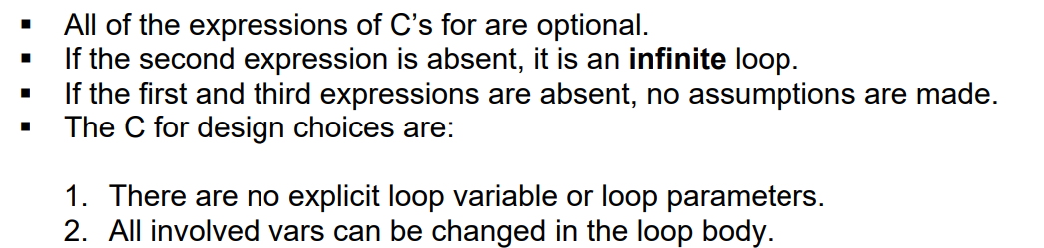

Slide 26
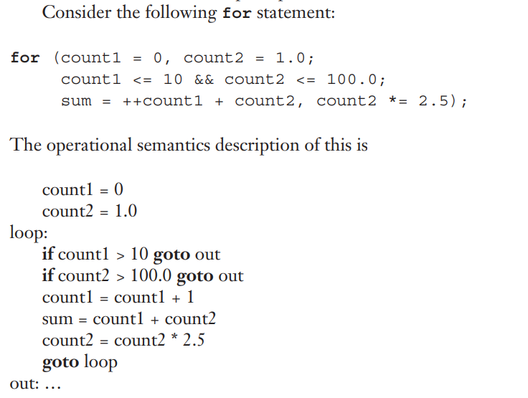

Slide 27
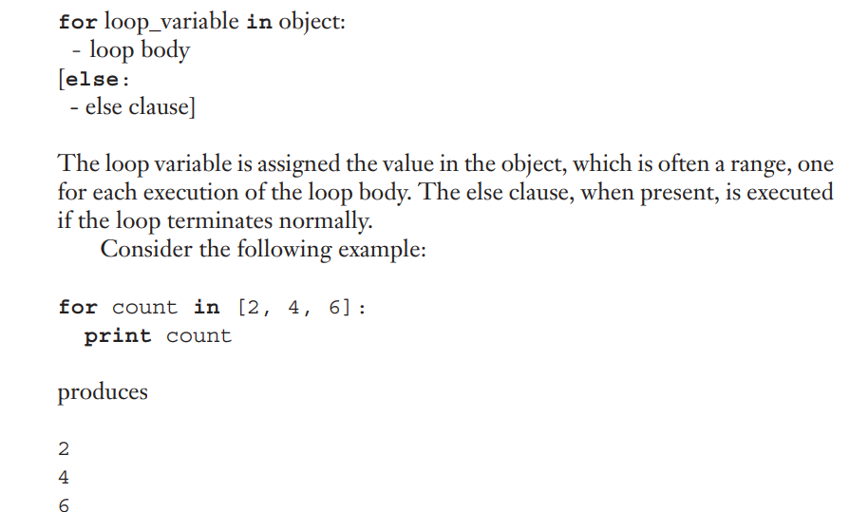
The for Statement of Python

Slide 28
For most simple counting loops in Python, the range function is used. range takes one, two, or three parameters.
The following examples demonstrate the actions of range:
range(5) returns [0, 1, 2, 3, 4]
range(2, 7) returns [2, 3, 4, 5, 6]
range(0, 8, 2) returns [0, 2, 4, 6]

Slide 29
Counter-Controlled Loops in Functional Languages
Rather than iteration to control repetition, functional languages use recursion.
Rather than a statement, functional languages use a recursive function
let rec forLoop loopBody reps =
if reps <= 0 then
()
else
loopBody()
forLoop loopBody, (reps - 1);;

Slide 30
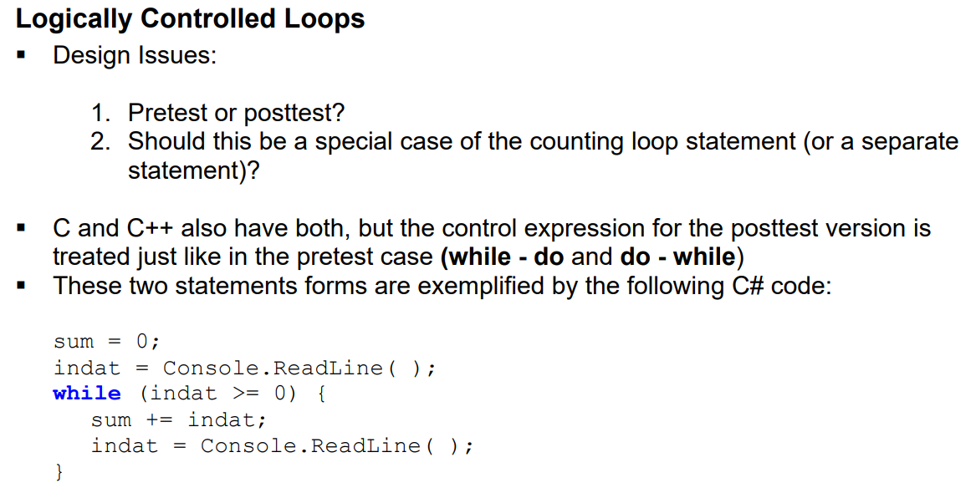

Slide 31
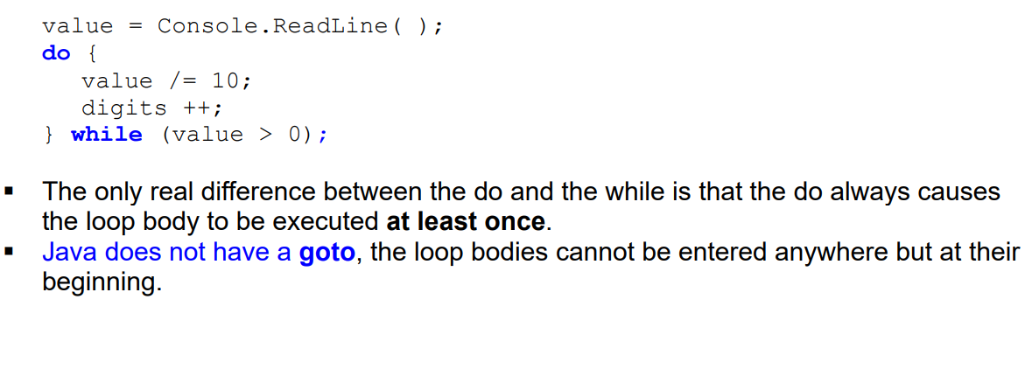

Slide 32
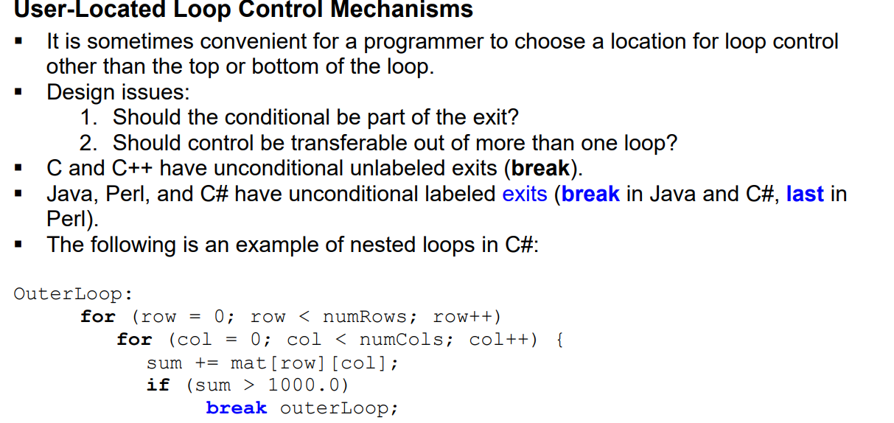

Slide 33
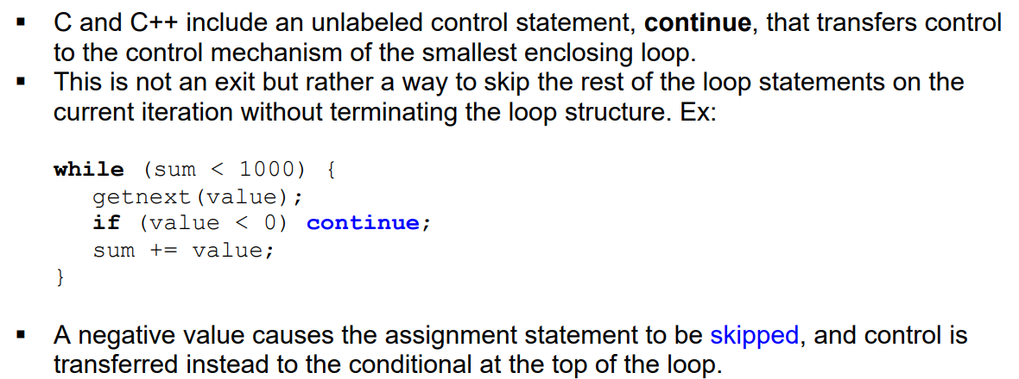
Both last and break provide for multiple exits from loops, which may seem to be somewhat of a hindrance to readability.

Slide 34
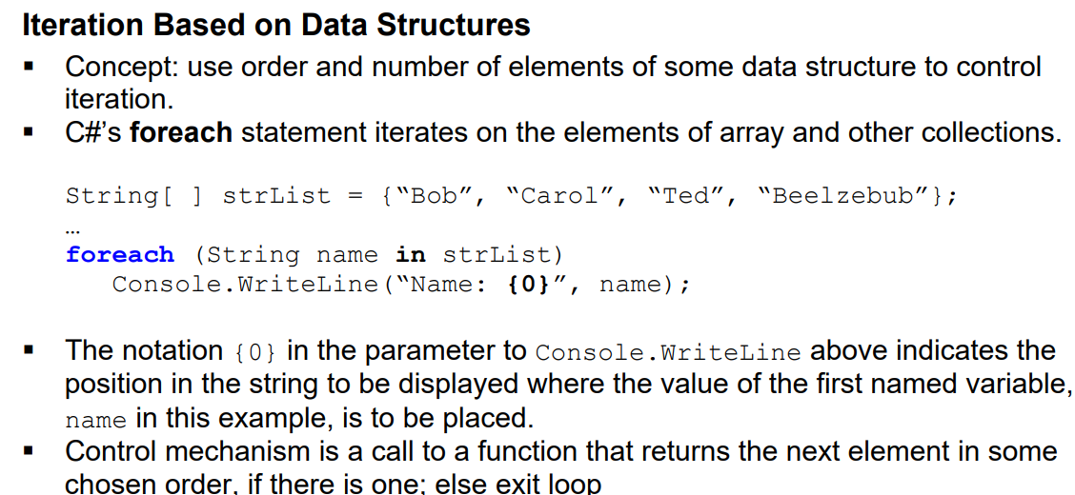

Slide 35
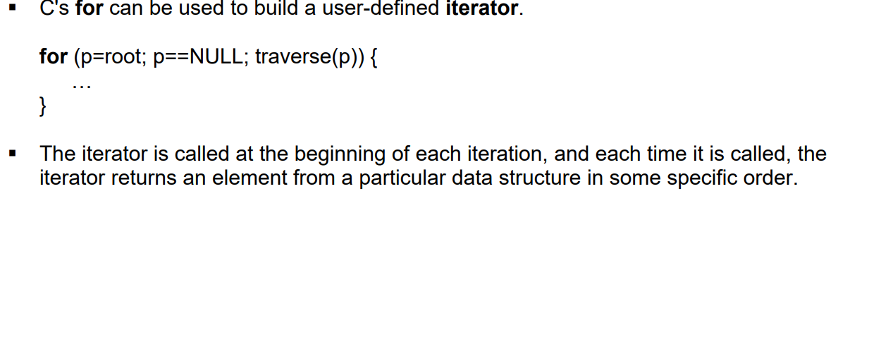

Slide 36
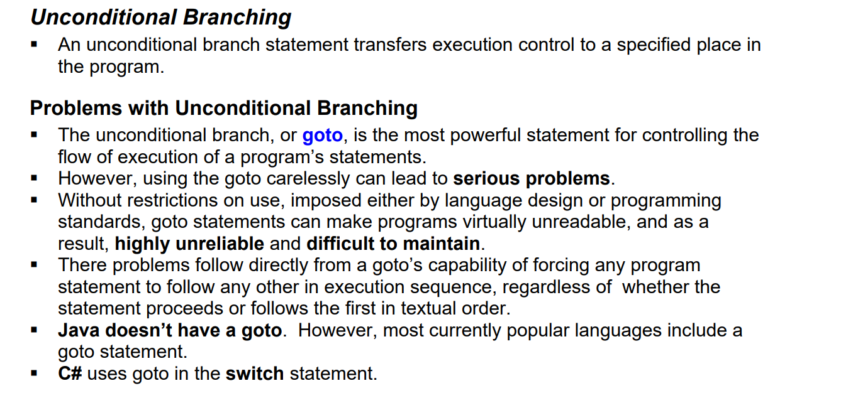

Slide 37
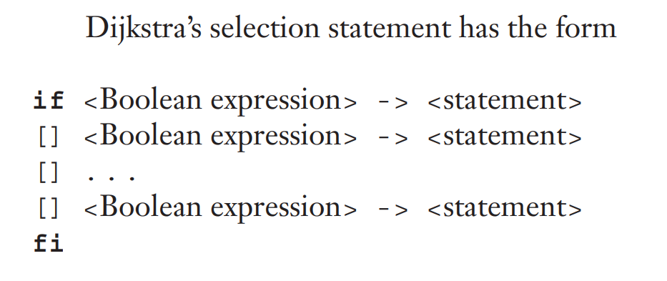
Guarded Commands
New and quite different forms of selection and loop structures were suggested by Dijkstra (1975).
His primary motivation was to provide control statements that would support a program design methodology that ensured correctness during development rather than when verifying or testing completed programs.

Slide 38
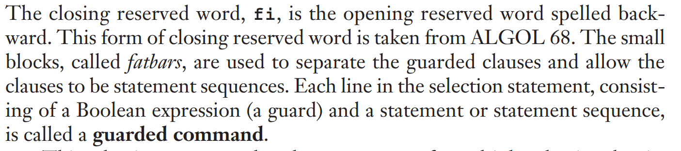

Slide 39
All of the Boolean expressions are evaluated each time the statement is reached during execution.
If more than one expression is true, one of the corresponding statements can be non-deterministically chosen for execution.
An implementation may always choose the statement associated with the first Boolean expression that evaluates to true.
But it may choose any statement associated with a true Boolean expression. So, the correctness of the program cannot depend on which statement is chosen (among those associated with true Boolean expressions).

Slide 40
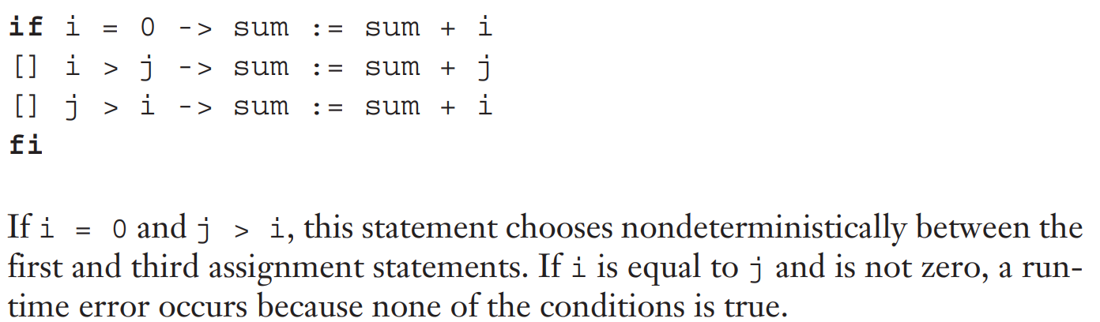
If none of the Boolean expressions is true, a run-time error occurs that causes program termination. This forces the programmer to consider and list all possibilities.
Consider the following example

Slide 41
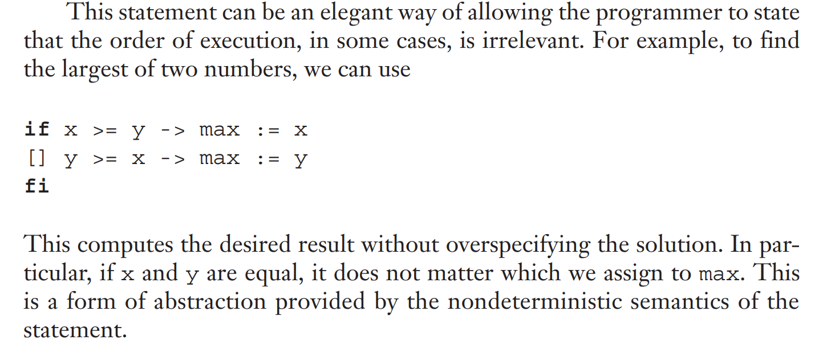

Slide 42
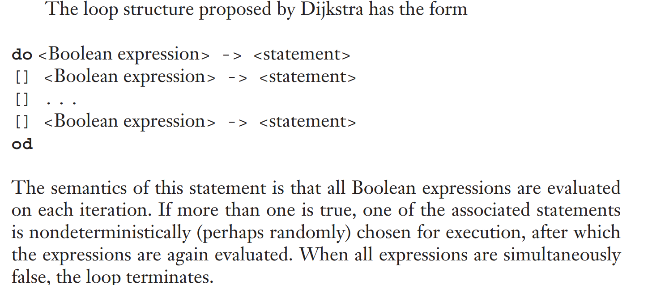

Slide 43
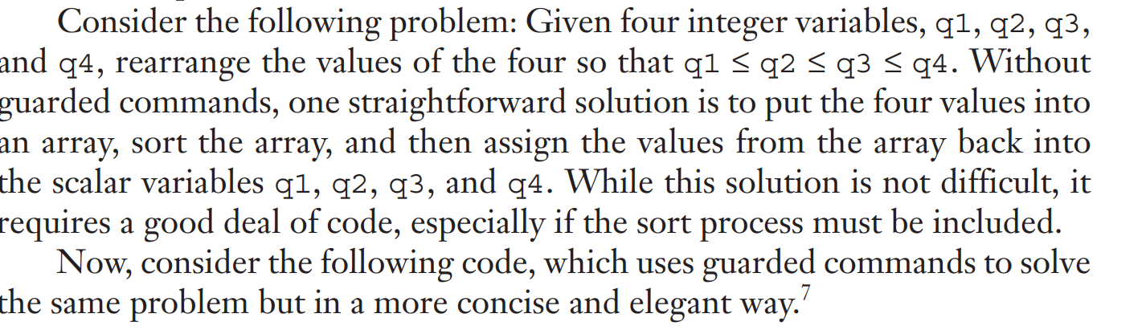

Slide 44
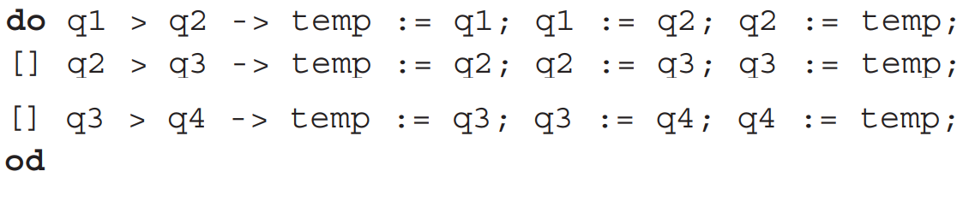

Slide 45
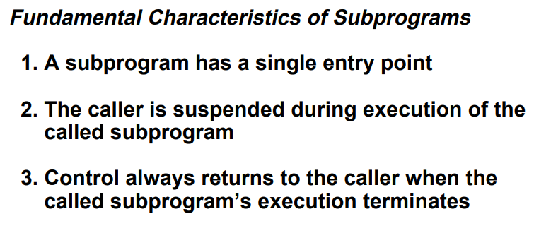
Subprograms

Slide 46
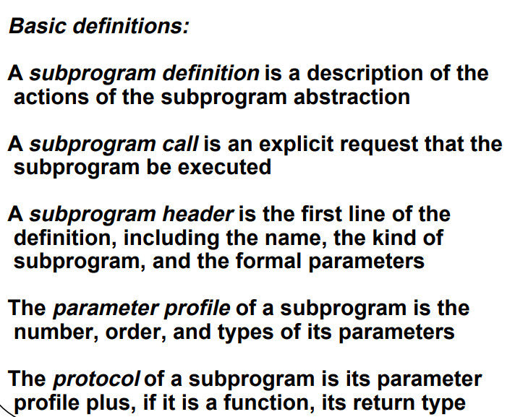

Slide 47
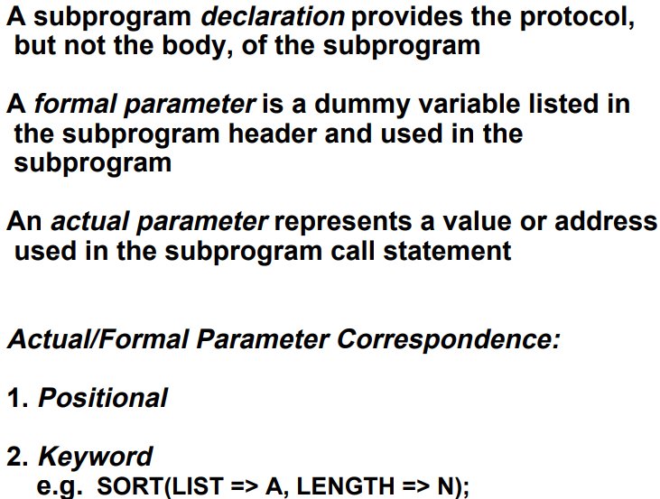

Slide 48
In nearly all programming languages, the correspondence between actual and formal parameters—or the binding of actual parameters to formal parameters—is done by position:
The first actual parameter is bound to the first formal parameter and so forth. Such parameters are called positional parameters.
This is an effective and safe method of relating actual parameters to their corresponding formal parameters, as long as the parameter lists are relatively short.

Slide 49
When parameter lists are long, it is easy for a programmer to make mistakes in the order of actual parameters in the list.
One solution to this problem is to provide keyword parameters, in which the name of the formal parameter to which an actual parameter is to be bound is specified with the actual parameter in a call.
The advantage of keyword parameters is that they can appear in any order in the actual parameter list.
Python functions can be called using this technique.

Slide 50
Python functions can be called using this keyword parameters technique, as in
sumer (length = my_length, list = my_array, sum = my_sum)
where the definition of sumer has the formal parameters length, list, and sum.
The disadvantage to keyword parameters is that the user of the subprogram must know the names of formal parameters.
In addition to keyword parameters, Ada, Fortran 95+ and Python allow positional parameters.
Keyword and positional parameters can be mixed in a call, as in sumer(my_length, sum = my_sum, list = my_array)

Slide 51
The only restriction with this approach is that after a keyword parameter appears in the list, all remaining parameters must be keyworded.
This restriction is necessary because a position may no longer be well defined after a keyword parameter has appeared.

Slide 52
Find out difference between a procedure and a function
There are two distinct categories of subprograms—procedures and functions
Both of which can be viewed as approaches to extending the language.
All subprograms are collections of statements that define parameterized computations.
Functions return values and procedures do not.
In most languages that do not include procedures as a separate form of subprogram, functions can be defined not to return values and they can be used as procedures.

Slide 53
The computations of a procedure are enacted by single call statements.
In effect, procedures define new statements.
For example, if a particular language does not have a sort statement, a user can build a procedure to sort arrays of data and use a call to that procedure in place of the unavailable sort statement.
In Ada, procedures are called just that; in Fortran, they are called subroutines.
Most other languages do not support procedures.

Slide 54
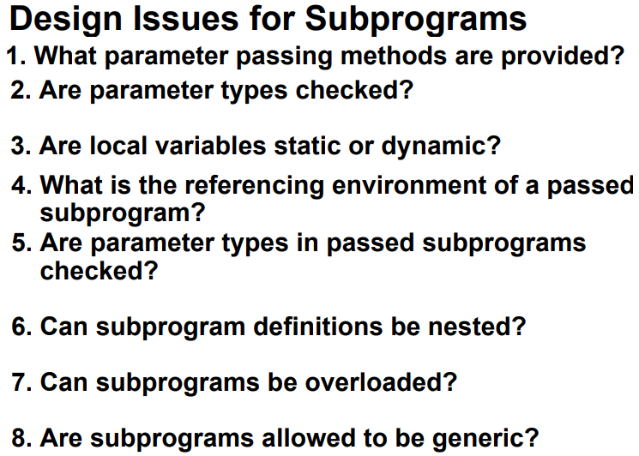
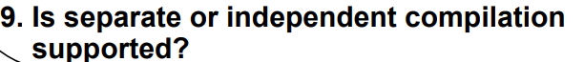

Slide 55
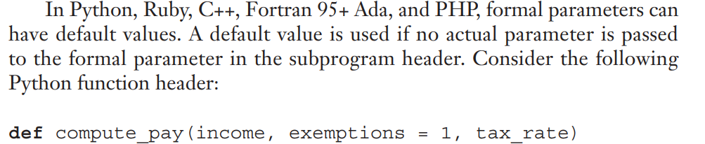

Slide 56
Local Referencing Environment
Subprograms can define their own variables, thereby defining local referencing environments.
Variables that are defined inside subprograms are called local variables, because their scope is usually the body of the subprogram in which they are defined
Local variables can be either static or stack dynamic.
If local variables are stack dynamic, they are bound to storage when the subprogram begins execution and are unbound from storage when that execution terminates

Slide 57
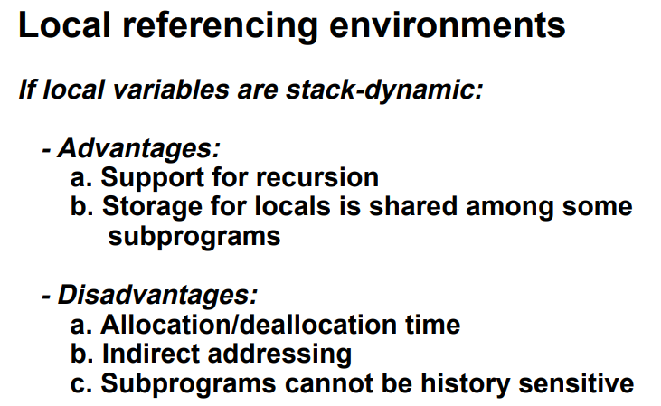

Slide 58
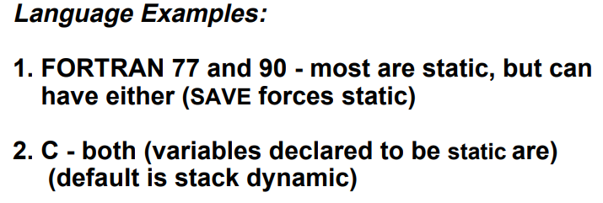
Static variables are allocated space in the data segment

Slide 59
Parameter Passing Methods
Semantic Models: in mode, out mode, inout mode
Conceptual Models of Transfer:
1. Physically move a value
2. Move an access path

Slide 60
Semantics Models of Parameter Passing
Formal parameters are characterized by one of three distinct semantics models:
(1) They can receive data from the corresponding actual parameter -> in mode
(2) they can transmit data to the actual parameter -> out mode
(3) they can do both -> inout mode

Slide 61
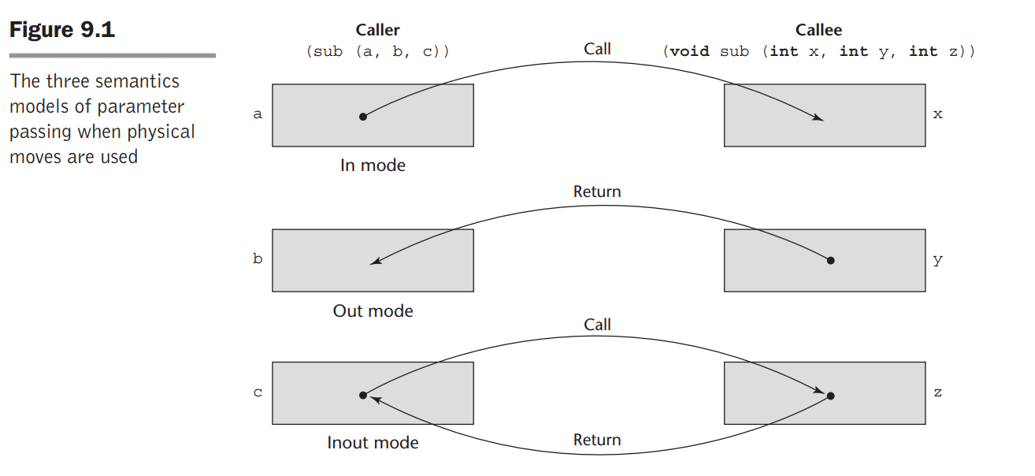
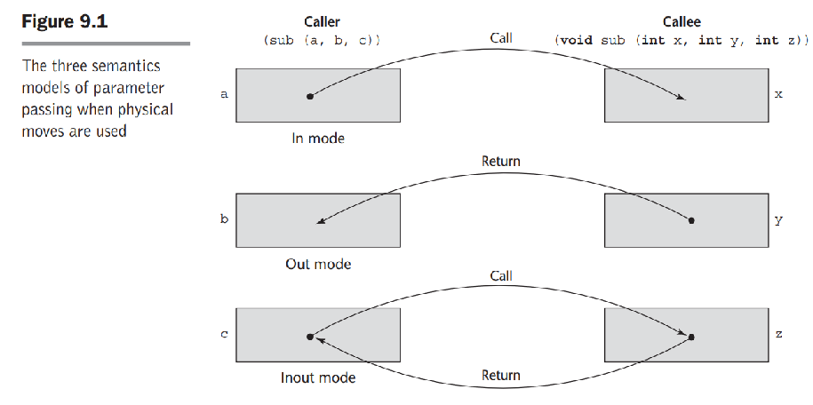

Slide 62
Formal parameters – Parameters in subroutine declaration
Actual parameters: Parameters in subroutine call

Slide 63
Implementation Models

Slide 64
Pass by value
Pass by value
When a parameter is passedby value, the value of the actual parameter is used to initialize the corresponding formal parameter, which then acts as a local variable in the subprogram, thus implementing in-mode semantics.
Pass-by-value is normally implemented by copy
The main disadvantage of the pass-by-value method if copies are used is that additional storage is required for the formal parameter

Slide 65
Pass by Reference
Pass-by-reference is a second implementation model for inout-mode parameters.
Rather than copying data values back and forth, however, as in pass-byvalue-result, the pass-by-reference method transmits an access path, usually just an address, to the called subprogram
The advantage of pass-by-reference is that the passing process itself is efficient, in terms of both time and space.
Duplicate space is not required, nor is any copying required.

Slide 66
Pass-by-Result
Pass-by-result is an implementation model for out-mode parameters.
When a parameter is passed by result, no value is transmitted to the subprogram.
The corresponding formal parameter acts as a local variable, but just before control is transferred back to the caller, its value is transmitted back to the caller’s actual parameter, which obviously must be a variable.
Local’s value is passed back to the caller
Disadvantages:
a. If value is passed, extra storage and the copy operations are required
b. Order dependence may be a problem - The order in which the actual parameters are copied determines the value of formal parameters with the same name.

Slide 67
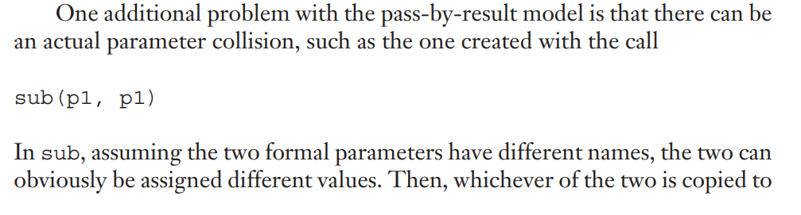
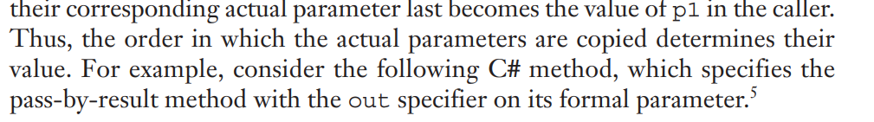

Slide 68
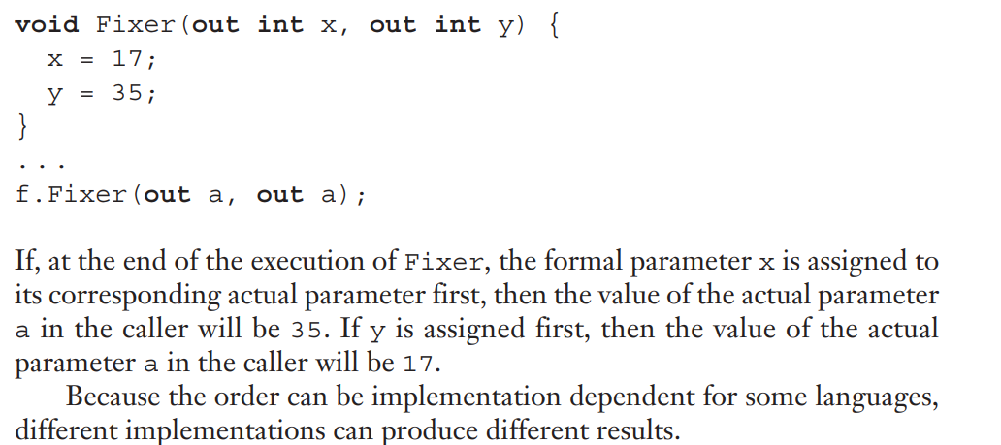

Slide 69
Pass-by-value-result (inout-mode)
Pass-by-value-result is an implementation model for inout-mode parameters in which actual values are copied.
It is in effect a combination of pass-by-value and pass-by-result.
The value of the actual parameter is used to initialize the corresponding formal parameter, which then acts as a local variable.
In fact, pass-by-value-result formal parameters must have local storage associated with the called subprogram.
At subprogram termination, the value of the formal parameter is transmitted back to the actual parameter.
Pass-by-value-result is sometimes called pass-by-copy

Slide 70
Disadvantages:
- Those of pass-by-result
- Those of pass-by-value

Slide 71
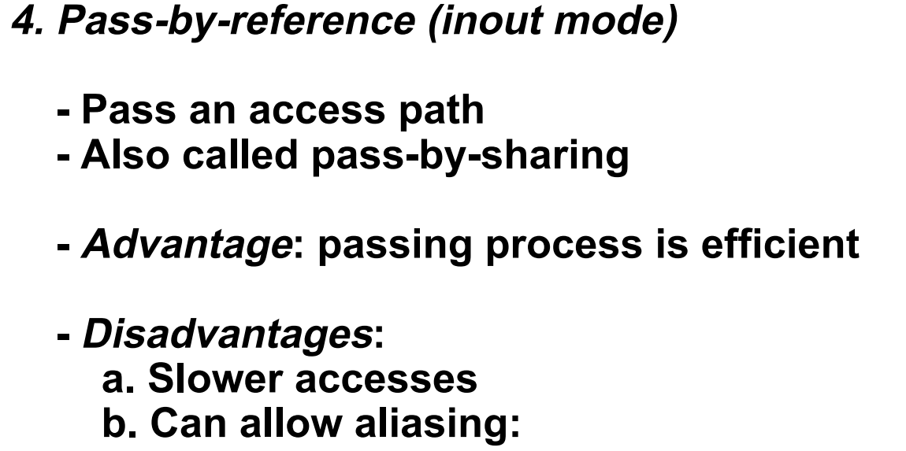

Slide 72
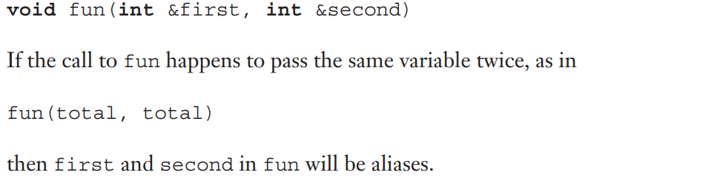
First, collisions can occur between actual parameters.

Slide 73
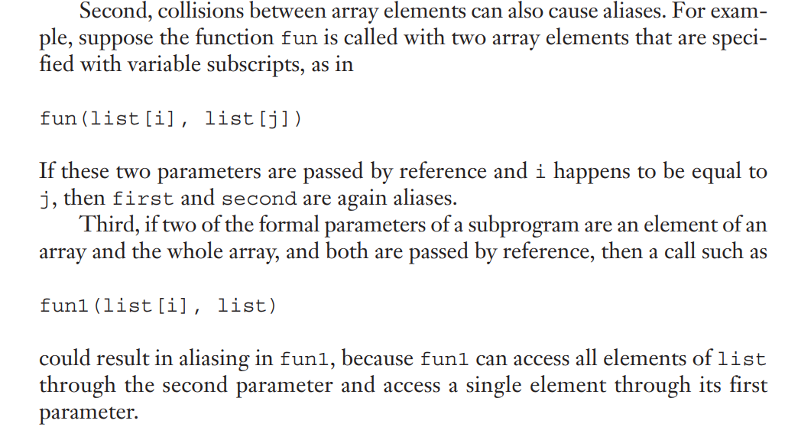

Slide 74
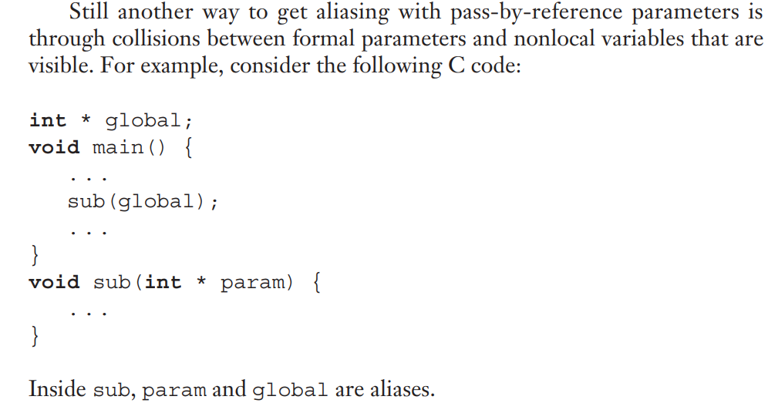

Slide 75
Pass-by-name (inout-mode)
When parameters are passed by name, the actual parameter is textually substituted for the corresponding formal parameter in all its occurrences in the subprogram.
Formals are bound to an access method at the time of the call, but actual binding to a value or address takes place at the time of a reference or assignment
- Purpose: flexibility of late binding
- Disadvantages of pass by name:
- Very inefficient references
- Too tricky; hard to read and understand

Slide 76


Slide 77


Slide 78


Slide 79
Overloaded Subprogram
An overloaded subprogram is a subprogram that has the same name as another subprogram in the same referencing environment.
Every version of an overloaded subprogram must have a unique protocol; that is, it must be different from the others in the number, order, or types of its parameters, and possibly in its return type if it is a function.
The meaning of a call to an overloaded subprogram is determined by the actual parameter list (and/or possibly the type of the returned value, in the case of a function).

Slide 80
C++, Java, Ada, and C# include predefined overloaded subprograms. For example, many classes in C++, Java, and C# have overloaded constructors.
Because each version of an overloaded subprogram has a unique parameter profile, the compiler can disambiguate occurrences of calls to them by the different type parameters.
Unfortunately, it is not that simple. Parameter coercions, when allowed, complicate the disambiguation process enormously.

Slide 81
Issue is that if no method’s parameter profile matches the number and types of the actual parameters in a method call, but two or more methods have parameter profiles that can be matched through coercions, which method should be called?
Overloaded subprograms that have default parameters can lead to ambiguous subprogram calls.

Slide 82


Slide 83
Generic Subprograms
Software reuse can be an important contributor to software productivity.
One way to increase the reusability of software is to lessen the need to create different subprograms that implement the same algorithm on different types of data.
For example, a programmer should not need to write four different sort subprograms to sort four arrays that differ only in element type.

Slide 84
A polymorphic subprogram takes parameters of different types on different activations.
Overloaded subprograms provide a particular kind of polymorphism called ad hoc polymorphism.
Languages that support object-oriented programming usually support subtype polymorphism.
Subtype polymorphism means that a variable of type T can access any object of type T or any type derived from T.

Slide 85
Parametric polymorphism is provided by a subprogram that takes generic parameters that are used in type expressions that describe the types of the parameters of the subprogram.
Different instantiations of such subprograms can be given different generic parameters, producing subprograms that take different types of parameters.
Parametric definitions of subprograms all behave the same. Parametrically polymorphic subprograms are often called generic subprograms

Slide 86

Generic Functions in C++

Slide 87


Slide 88

Function Call max <int> (3,5)

Slide 89


Slide 90
The following is an example instantiation of this template function
float flt_list[100];
. . .
generic_sort(flt_list, 100);

Slide 91
Closure
A closure is a subprogram and the referencing environment where it was defined
If a static-scoped programming language does not allow nested subprograms, closures are not useful, so such languages do not support them.
All of the variables in the referencing environment of a subprogram in such a language (its local variables and the global variables) are accessible, regardless of the place in the program where the subprogram is called.

Slide 92
When subprograms can be nested, in addition to locals and globals, the referencing environment of a subprogram can include variables defined in all enclosing subprograms
A variable whose lifetime is that of the whole program is said to have unlimited extent.
This usually means they must be heap-dynamic, rather than stack-dynamic.

Slide 93
Coroutines

Slide 94
Definition
A coroutine is a special kind of subprogram.
The coroutine control mechanism is often called the symmetric unit control model.
Coroutines can have multiple entry points, which are controlled by the coroutines themselves.
Coroutines are general control structures where flow control is cooperatively passed between two different routines without returning.
Their execution is interleaved.

Slide 95

Subroutines are called by a main function that is responsible for coordinating the use of several subroutines

Slide 96



Slide 97


Slide 98

Alternative

Slide 99

Each branch off the stack contains the frames of a separate coroutine
Each branch to side represents creation of a coroutine(A,B,C,and D)
Static links are shown as arrows
Dynamic links are shown by vertical arrangement

